Slide 1






Supervised Machine Learning
ANKIT MIRAJKAR

Slide 2
AGENDA
Supervised Machine Learning
Algorithms
Linear Regression
Use cases
Linear vs Logistic regression
Finding best fit regression line using Least square method
Checking goodness of fit using R2 Method

Slide 3
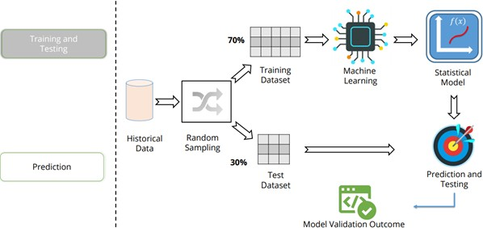
SUPERVISED MACHINE LEARNING
Supervised learning is the types of machine learning in which machines are trained using well "labelled" training data, and on basis of that data, machines predict the output.
Linear Regression
Logistics Regression Decision tree
Random forest

Slide 4
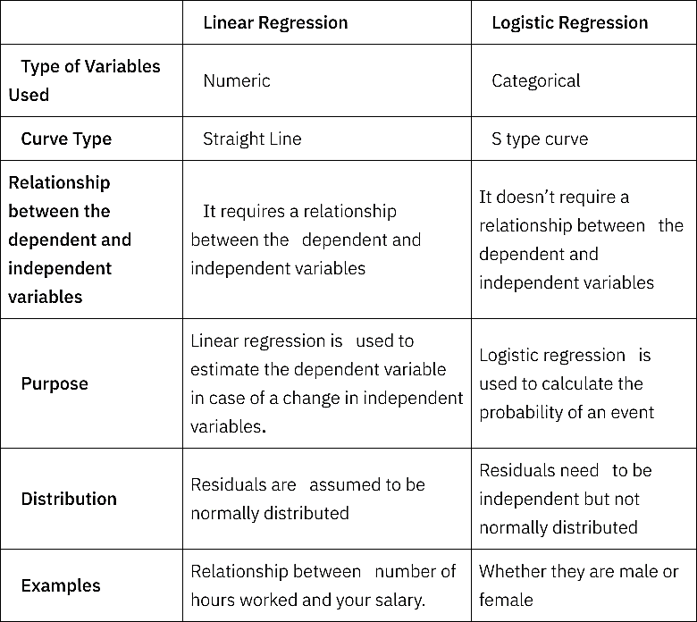
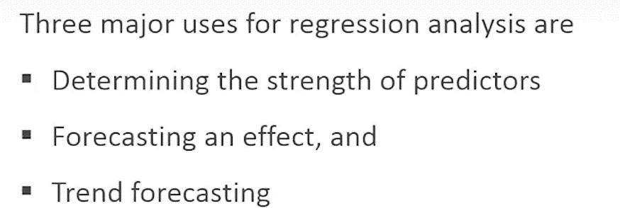
REGRESSION
Regression analysis is a statistical method to model the relationship between a dependent (target) and independent (predictor) variables with one or more independent variables

Slide 5


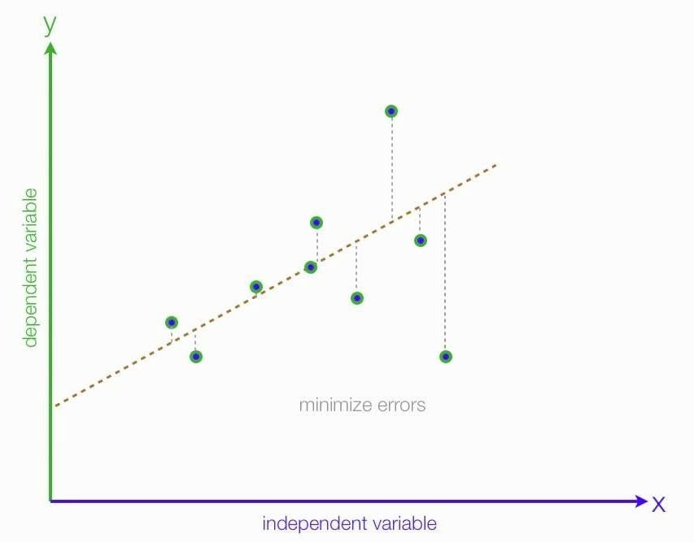
LINEAR REGRESSION
Selection criteria:
Classification and regression capabilities
Data quality
Computational complexity
Comprehensible and Transparent
Where is it used?
Evaluating trend and sales estimates
Analyze the impact of price change
Assessment of risks in financial and insurance domain

Slide 6
Assumptions for linear regression
Here are some assumption that must be satisfied for the linear regression model to be valid.
Linearity: The relationship between the independent and dependent variables should be linear.
Independence: Observations should be independent of each other.
Normality: The dependent variable is normally distributed for a fixed value of the independent variable.
No Multicollinearity: This is more pertinent for multiple regression, where all independent variables should be independent.
Limitations of Linear Regression
Outliers: This can significantly impact the slope and intercept of the regression line.
Non-linearity: Linear regression assumes a linear relationship, but this assumption may sometimes not hold.

Slide 7
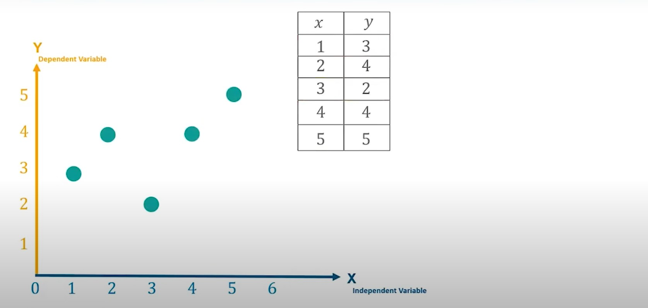

Slide 8
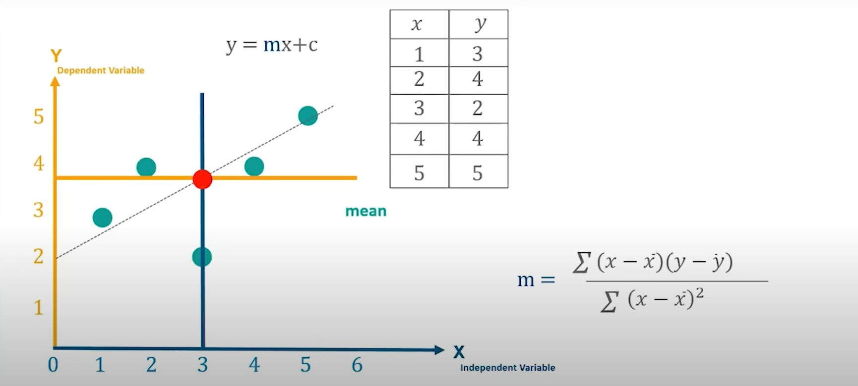

Slide 9
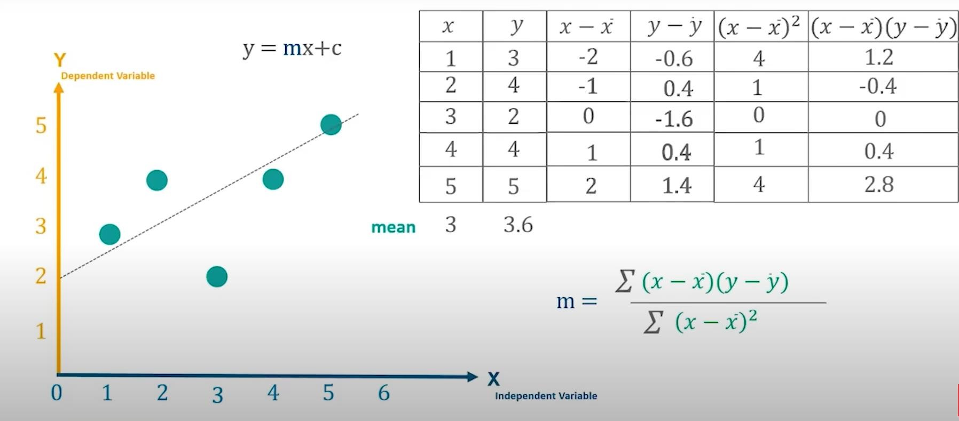

Slide 10
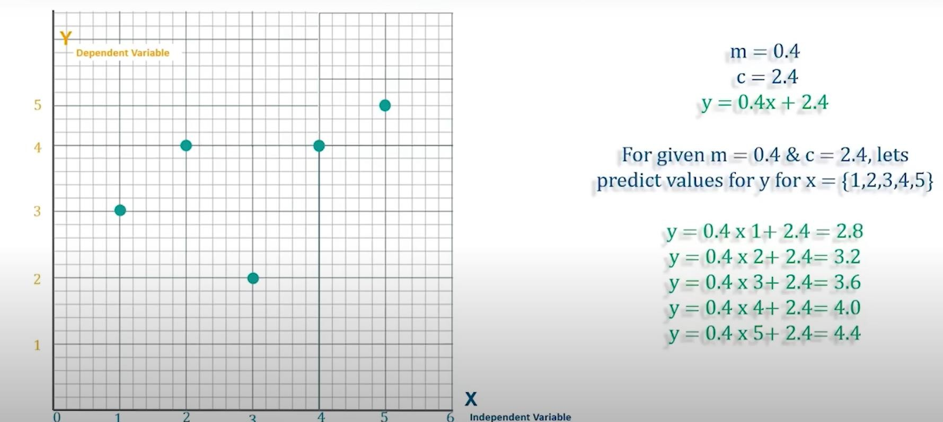
MEAN SQUARE ERROR

Slide 11
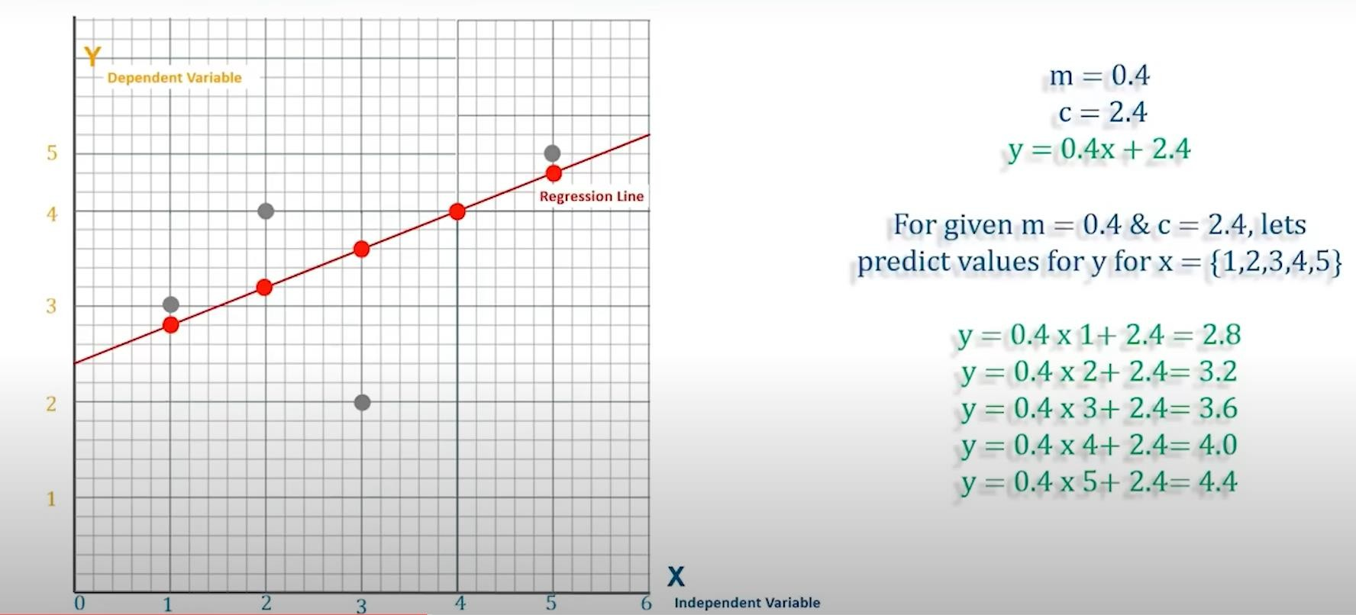
MEAN SQUARE ERROR

Slide 12
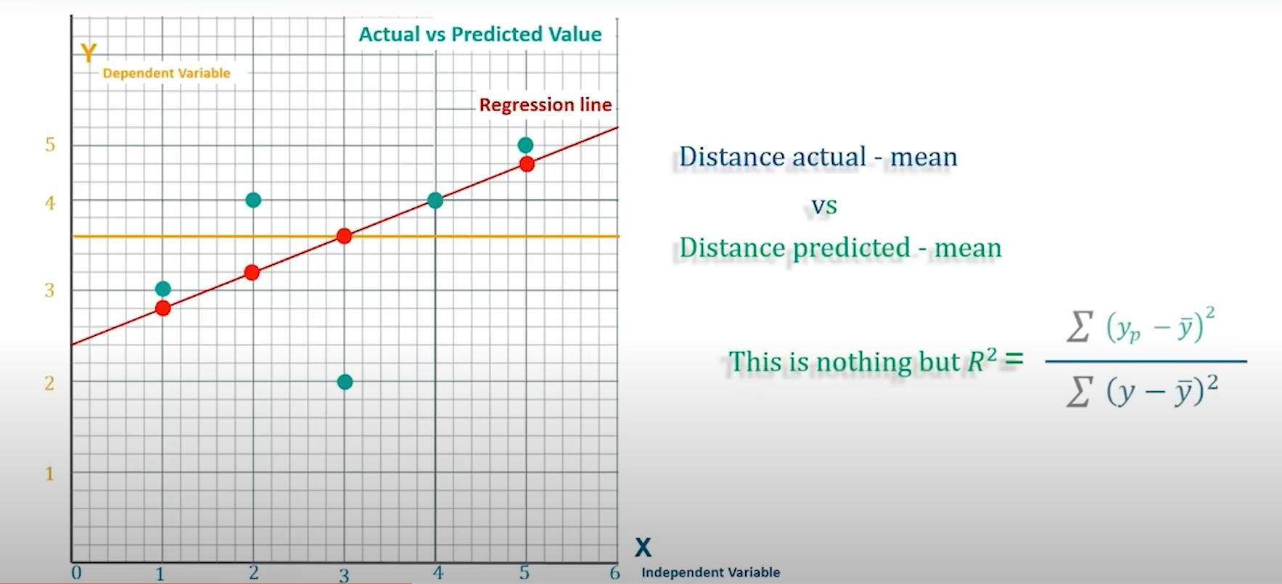
GOODNESS OF FIT
R-Squared value?
It is a statistical method of how close the data are to the fitted regression line
It is known as coefficient of determination

Slide 13
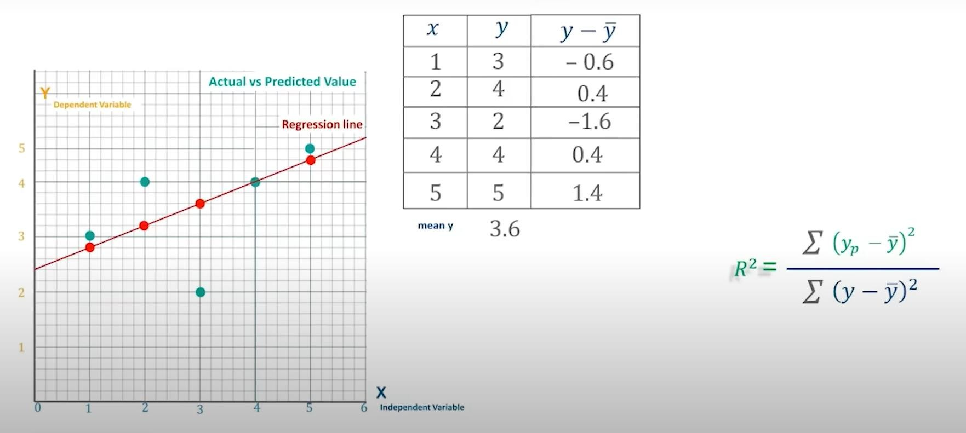
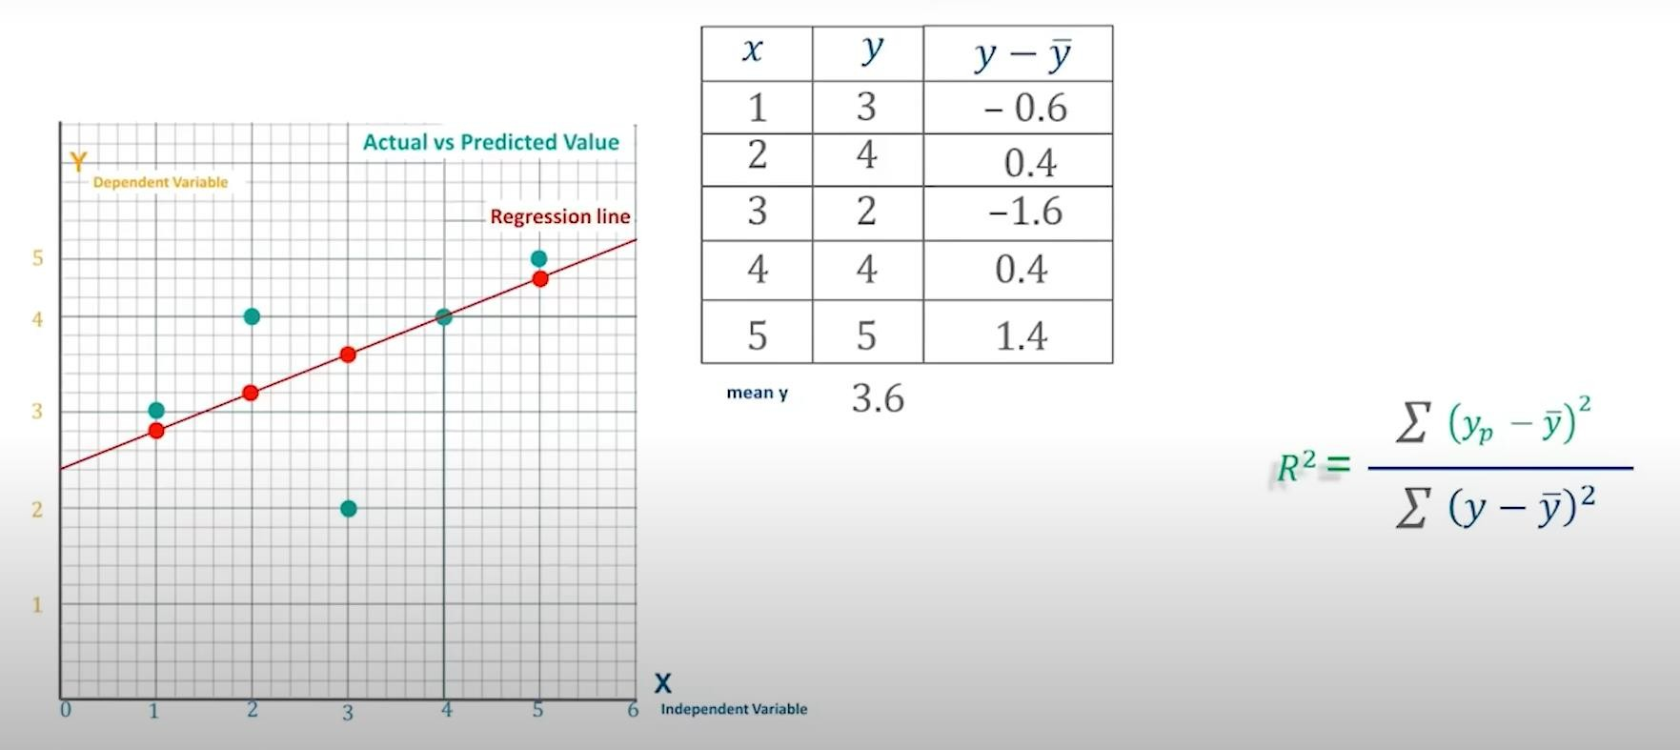
CALCULATION OF R2

Slide 14
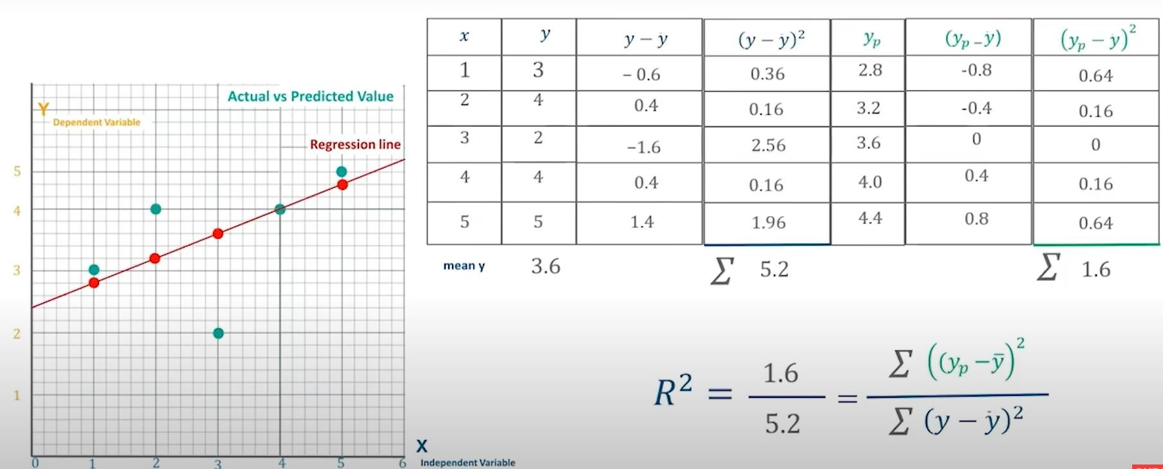

Slide 15
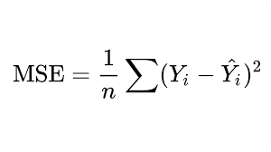
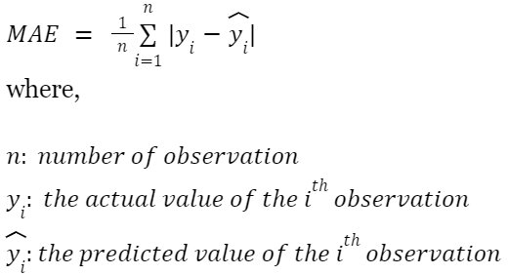
MSE and MAE

Slide 16
Multiple Linear Regression (MLR)
It is a statistical technique that uses several explanatory variables to predict the outcome of a response variable.
Multiple regression is the extension of ordinary least-squares (OLS) regression because it involves more than one explanatory variable.
​yi​=β0​ + β1​xi1 ​+ β2​xi2 ​+ ... + βp​xip ​+ ϵ
where, for i=n observations:
yi​=dependent variable
xi​=explanatory variables
β0​=y-intercept (constant term)
βp​=slope coefficients for each explanatory variable
ϵ=the model’s error term (also known as the residuals)​
Example: Let's say you want to predict the price of a house based on its square footage and number of bedrooms. The multiple linear regression model might look like this:
Price = b0 + b1 * SquareFootage + b2 * NumberBedrooms
Price is the dependent variable.
SquareFootage and NumberBedrooms are independent variables.
b0, b1, and b2 are coefficients determined by the model.

Slide 17
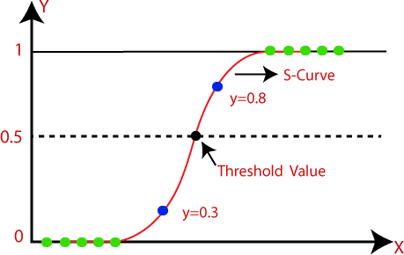
LOGISTIC REGRESSION
It is used to calculate / predict the probability of a binary (yes/no) event occurring.
An example of logistic regression could be applying machine learning to determine if a person is likely to be
infected with COVID-19 or not.
Since our value of Y will be between 0 and 1, the linear line must be clipped at 0 & 1

Slide 18
LOGISTIC REGRESSION : USE CASE
Weather prediction
Classification problem
Determine illness
USE CASE:
Titanic Dataset analysis: Explore titanic dataset and explore about the people, both those who survived and those who did not. What factors were responsible?
SUV Data Analysis: A car segment has released a new SUV in the market. Using previous data about their sales of their SUV, they want to predict the category of people who might be interested in buying this car.

Slide 19
IMPLEMENT REGRESSION
Collecting data
Analyzing data
Data wrangling
Train & Test
Accuracy check

